Slide 1
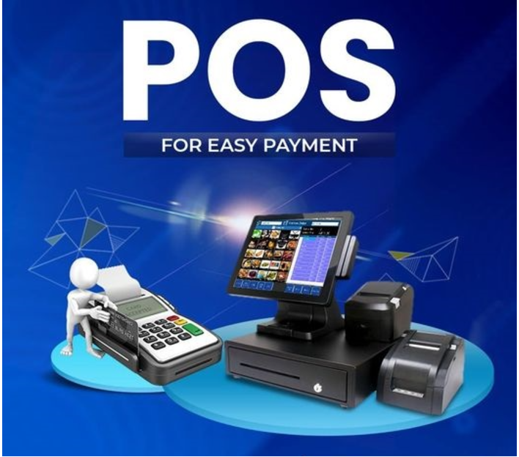
Dhiya
DADS student

Slide 2


Slide 3
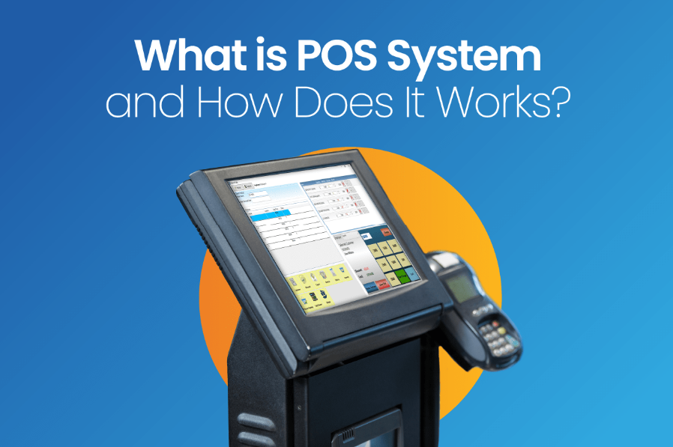

Slide 4
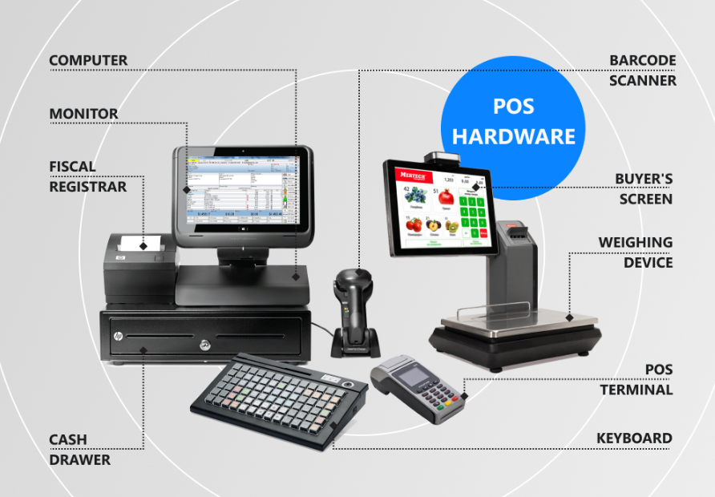

Slide 5
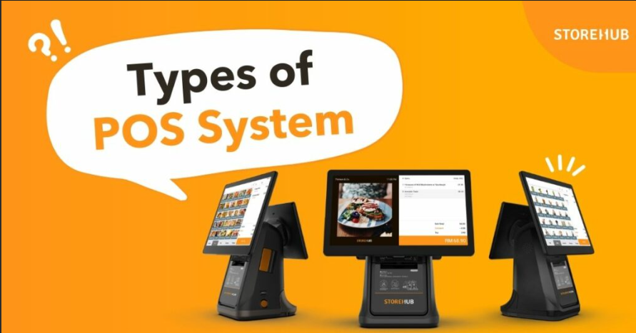

Slide 6
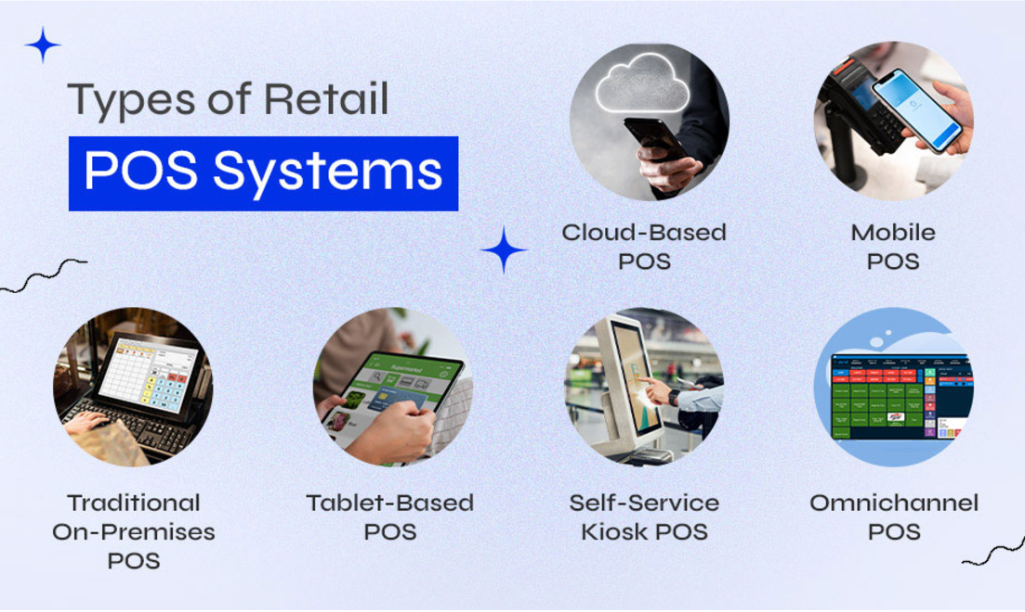

Slide 7
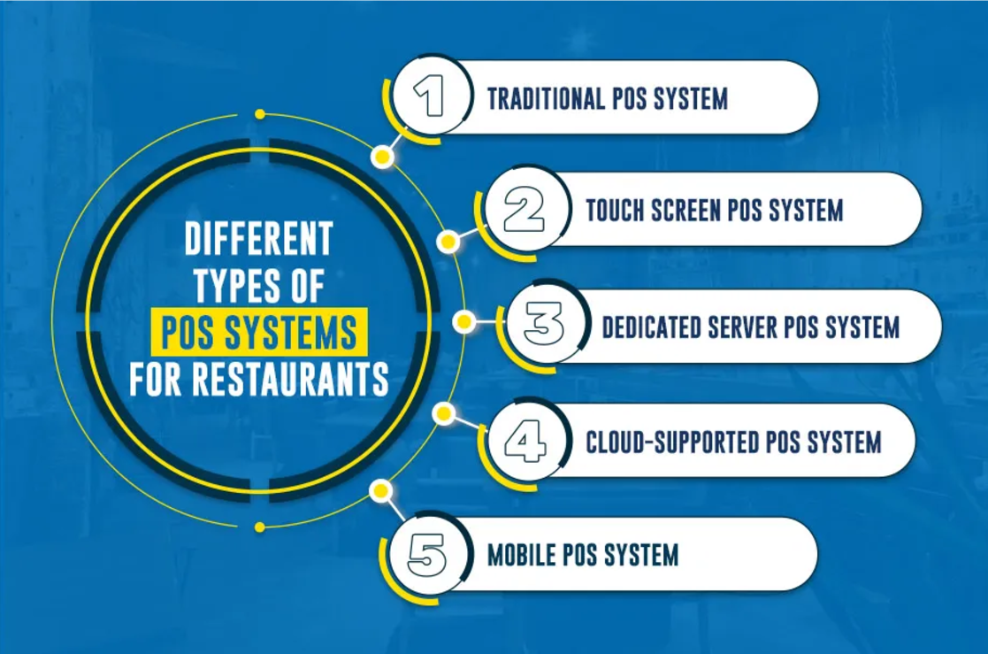

Slide 8


Slide 9
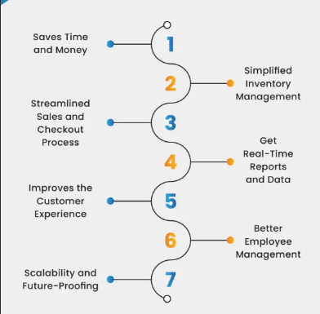

Slide 10


Slide 11
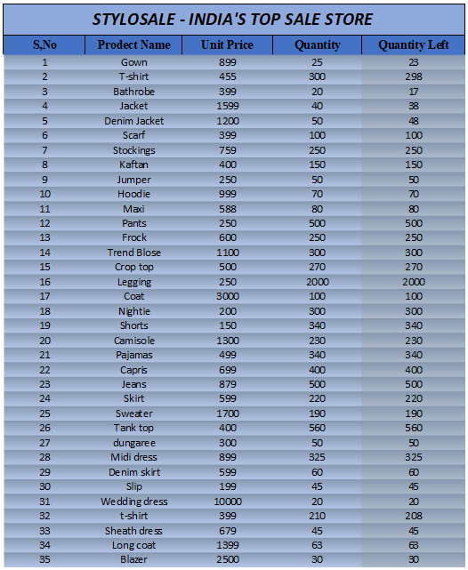
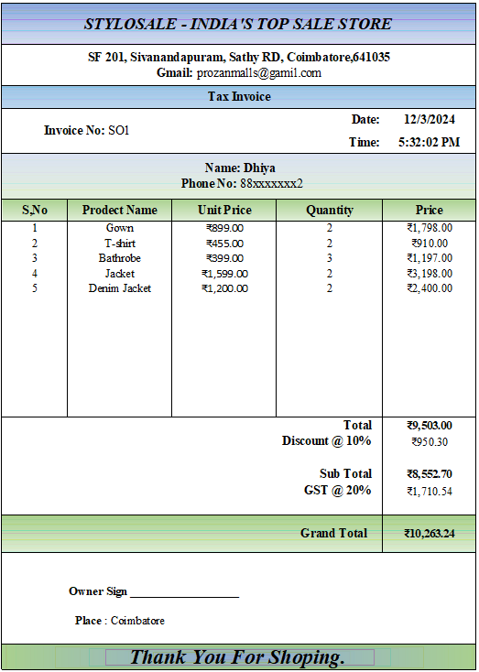
=IF(ISERROR(MATCH(B3,Sheet1!$B$8:$B$45,0)),D3, D3-VLOOKUP(B3,Sheet1!$B$8:$D$45,3,FALSE))

Slide 12
Date = Today()
Time = Now()
Unit Price = IF(ISBLANK(B8)," ",VLOOKUP(B8,Sheet2!$B$3:$E$37,2,FALSE))
(Unit Price of the Product)
Quantity = How much does the customer want?
Price = IF(ISBLANK(B8)," ",D8*C8) (Quantity * Unit Price)
Total = SUM(E8:E20) (Sum of Prices)
Discount @10% = 10%*E21 (10% * Total)
Sub Total = E21-E22 (Total -- Discount @10% )
GST @ 20% = 20%*E24 (20%* Sub total)
Grant Total = E24+E25 ( Sub Total + GST)
Finally Generate my Tax Invoice
Thank You

Slide 14

This Photo by Unknown Author is licensed under CC BY

